Slide 1

DMA-L GLOB PROJECT-1
Road Accident Analysis Using Python
Domain: Python
Category- Software
Batch ID- 17
THOTAPELLI SATHWIK ( 22241A3257 )
PULYALA AKSHAY ( 22241A3245 )
BURLE SHASHANK ( 22241A3252 )

Slide 2
Contents
Introduction and Objectives
Dataset and Methodology
Exploratory Analysis and Modelling
Results and Interpretation
Conclusion and Future Work

Slide 3
Introduction and Objectives
Introduction
Background:
Road accidents are a leading cause of death and injury worldwide, with millions affected each year. With increasing urbanization, population growth, and vehicular density, analyzing road accident data has become essential to understanding and addressing the factors contributing to traffic-related incidents. Publicly available accident datasets offer a powerful resource for studying patterns and developing preventive strategies.
Why It Matters:
By leveraging Python and data analytics, this project aims to extract meaningful insights from road accident datasets. This analysis can aid in identifying high-risk zones, time periods with increased accident probability, and correlations with environmental or human factors. The findings support decision-making for traffic management, road safety improvements, and policy formulation aimed at reducing accident rates.
Problem Statement:
Despite the availability of large-scale road accident data, much of it remains underexplored. Current analysis methods are often limited to surface-level statistics, missing deeper patterns such as temporal trends, location- based risk factors, or weather influence. This gap hinders the development of targeted safety measures and informed infrastructure planning.

Slide 4
Introduction and Objectives
Objectives
Merge and Clean Accident Datasets:
Integrate and preprocess raw accident datasets to ensure data consistency, handle missing values, and remove
duplicates for accurate analysis.
Analyze Accident Patterns and Trends:
Examine accident frequency based on variables such as time, location, vehicle type, weather conditions, and road types to identify significant patterns.
Severity and Cause Correlation:
Study the correlation between accident severity and contributing factors like speed, lighting, alcohol involvement,
and road surface conditions.
Visualization:
Create clear and interactive visualizations (heatmaps, bar graphs, time-series plots) to highlight accident hotspots, peak accident hours, and seasonal trends.
Provide Strategic Insights:
Generate actionable insights to support policymakers, traffic authorities, and urban planners in designing effective safety measures and infrastructure improvements.

Slide 5
DATASET
Dataset Description
Sources:
The dataset used in this project is sourced from Kaggle’s India Road Accidents, Vehicles, and Casualties. It offers detailed records of road traffic accidents in India over multiple years, compiled from police accident reports.
The key files include:
Accidents.csv – Contains data on each reported accident including location, severity, weather, and time.
Vehicles.csv – Details about vehicles involved in the accidents such as type, maneuver, and vehicle age.
Casualties.csv – Information about casualties including age, severity, and casualty class (driver, passenger, pedestrian).
Scope:
The dataset spans several years, covering thousands of road accidents across various regions in India. It includes detailed records about accident conditions, vehicle involvement, and casualty details, making it suitable for exploratory and predictive analysis.

Slide 6
DATASET
Features:
Accident Severity: Classified as Fatal, Serious, or Slight.
Date & Time: Precise timestamp of when the accident occurred.
Weather Conditions: Weather at the time of the accident (rain, fog, etc.).
Light Conditions: Whether it occurred during daylight, darkness, etc.
Road Type & Surface: Describes the road layout and condition.
Vehicle Type: Car, motorcycle, bus, heavy goods vehicle, etc.
Data Challenges:
Missing Values:
Several records have missing or null entries in critical fields such as weather conditions, road surface, vehicle type, and casualty age, which required careful handling during preprocessing.
Inconsistent Formats:
Some columns, such as date and time, were stored in inconsistent or non-standard formats, requiring transformation before analysis.
Categorical Variations:
Different spellings or formats for the same category (e.g., "Fine" vs "Clear" weather) led to label inconsistencies
across entries.
6

Slide 7
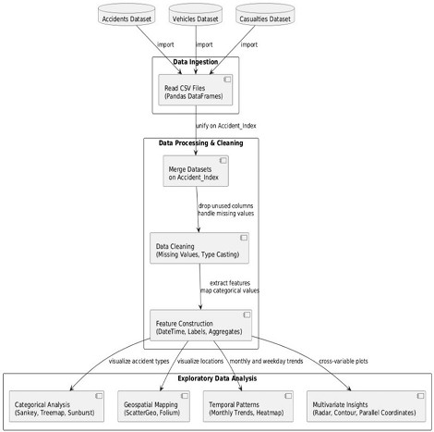
Methodology
Methodology / Workflow
Raw Datasets:
Three primary CSV files—Accidents.csv, Vehicles.csv, and Casualties.csv—are used as the main data sources.
Data Loading:
The datasets are loaded into a Jupyter Notebook using Pandas for initial inspection, structure understanding, and data cleaning.
Merging Datasets:
The three datasets are merged using common keys like Accident_Index to consolidate accident, vehicle, and casualty information into a unified dataset.
Exploratory Data Analysis (EDA):
Statistical summaries and trends are explored, such as accident severity, time- of-day distribution, vehicle type involvement, and weather conditions.
Data Visualization:
Python libraries like Matplotlib and Seaborn are used to create visualizations
including bar graphs, heatmaps, pie charts, and time-series plots.
Insights & Interpretation:
Architecture diagram:
Key insights are extracted from the data to identify accident hotspots, high-risk time windows, and the impact of environmental conditions on accident severity.
7

Slide 8
Data Preprocessing
Key preprocessing steps include:
Handle Nulls and Duplicates:
Imputed or removed missing values in critical fields like weather conditions, vehicle type, road surface, and casualty age. Removed duplicate accident entries to maintain dataset integrity.
Merge Related Data:
Merged Accidents, Vehicles, and Casualties datasets using Accident_Index to create a comprehensive view of each incident.
Feature Extraction:
Created new features like hour of the day, day of the week, and accident severity groupings to support deeper analysis.
Analytical Techniques
Descriptive Statistics:
Examined distributions of accident time, severity, vehicle types, and age groups involved.
Comparative Analysis:
Compared accident frequencies across regions, times of day, and weather conditions to detect high-risk scenarios.
Trend Analysis:
Analyzed year-on-year and seasonal trends in accidents, enabling insights into temporal accident patterns and policy impact over time.
8

Slide 9



Tools & Technologies Used
The analysis is performed using Python, leveraging the following key libraries and tools:
Pandas – For efficient data loading, cleaning, merging, and manipulation.
Matplotlib – For creating static, interactive, and animated visualizations.
Seaborn – For advanced statistical plotting and enhanced chart aesthetics.
Jupyter Notebook – As the development environment for interactive coding and visualization.
9

Slide 10
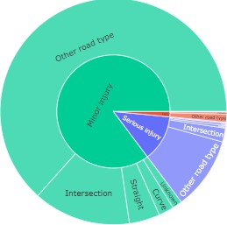
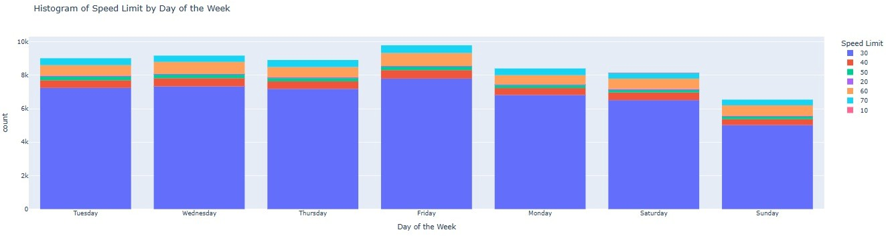
Exploratory Data Analysis
Histogram of Accident Time Distribution:
Shows the frequency of accidents by hour, revealing peak times such as rush hours or nighttime danger zones.
Line Plot of Accidents Over the Years:
Displays the trend in the number of accidents over time, highlighting the effectiveness of safety policies or any seasonal patterns.
Bar Chart of Accident Severity:
Illustrates the distribution of accidents by severity (Slight, Serious, Fatal), helping understand the impact level of most incidents.
Heatmap of Regions vs. Accident Count:
Visualizes accident density across different regions, helping identify hotspots where intervention may be most needed.
10

Slide 11
Results and Interpretation
Key Insights
Peak Accident Times Identified:
Most accidents occur during morning and evening rush hours, with a noticeable increase during low-light conditions.
Weather and Light Impact:
Accidents are significantly more frequent in rainy or foggy weather and during nighttime or low visibility conditions.
High-Risk Vehicle Types:
Certain vehicle types like motorcycles and heavy goods vehicles are disproportionately involved in severe accidents.
Implications
Time-Based Traffic Regulations:
Enhanced traffic enforcement and awareness campaigns during peak hours could reduce accident rates.
Weather-Based Alerts:
Implementing real-time road condition alerts and adaptive driving policies during adverse weather may improve safety.
Infrastructure Planning:
Insights can guide urban planners to improve road design in high-risk zones and create safer pedestrian pathways.
11

Slide 12
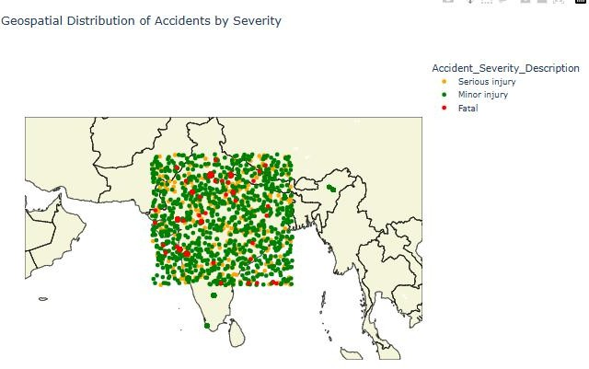
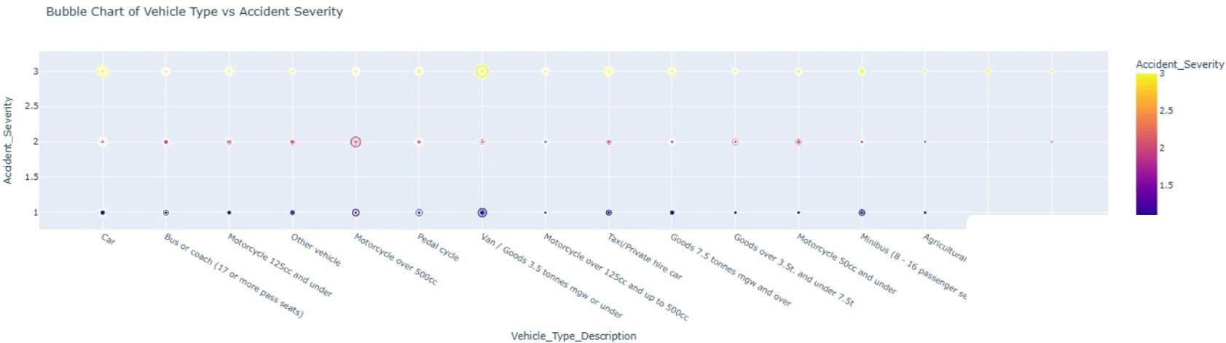
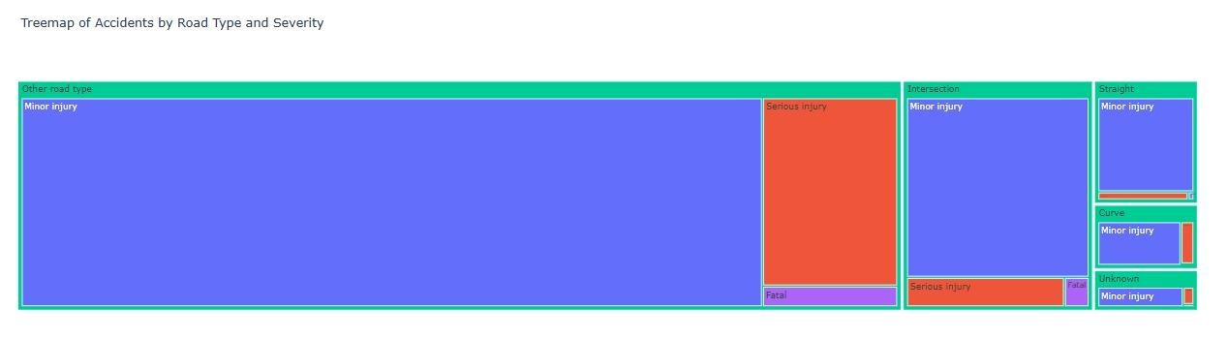
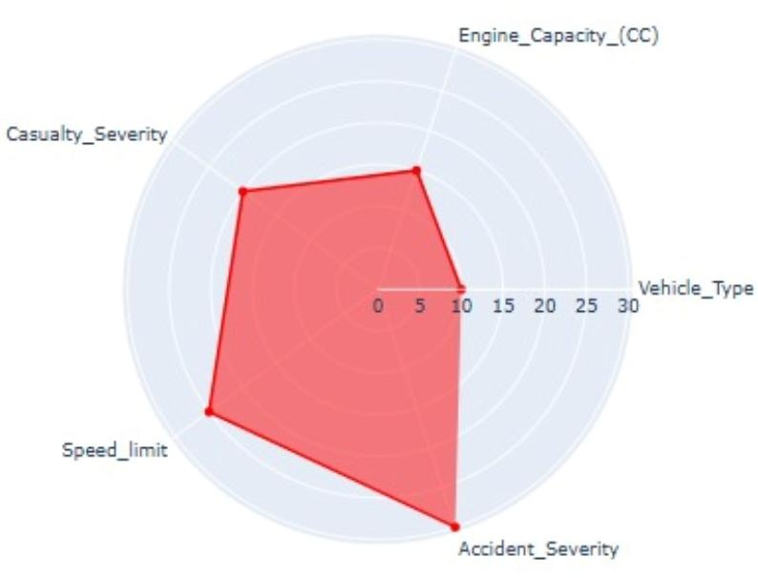
Results and Interpretation
12

Slide 13
Conclusion
Conclusions:
The road accident dataset reveals clear patterns in accident timing, severity, and environmental factors, offering actionable insights for traffic safety improvements.
Visual analytics effectively highlight high-risk factors such as specific time windows, weather conditions, and vehicle types, enabling better data-driven decisions in road safety planning.
Limitations:
Static Historical Data:
The dataset reflects only past incidents and may not capture recent trends or changes in traffic policies post data collection.
Missing Contextual Factors:
Lacks integration with real-time traffic volume, driver behavior, or infrastructure quality, which could enhance analysis depth.
Future Work:
Machine Learning for Risk Prediction:
Apply classification or regression models to predict accident severity or likelihood based on conditions.
Interactive Dashboards (Streamlit):
Develop user-friendly dashboards for policymakers or citizens to explore accident patterns dynamically.
13

